Slide 1
E-Commerce Sales Analysis
Turning Sales Data into Smart Decisions.”
Problem Statement :
The company has large e-commerce sales data but lacks clear insights into which products, regions, and customers drive revenue and profit. This makes it difficult to improve sales performance and business decisions.
The goal of the analysis is to identify key trends, top performers, and problem areas to help the company increase sales and profitability.

Slide 2
Project Objective:-
The goal of this project is to analyze E-commerce sales data to uncover insights such as:
- Which regions, categories, and products contribute most to sales and profit
- How discounts affect profit margins
- Monthly sales and profit trends
- Payment mode preferences

Slide 3
Dataset Overview:-
The dataset consists of two CSV files:
1. Details.csv - contains product and sales details
2. Orders.csv - contains order information such as customer, date, and region
Total Records: 500
Columns: Order ID, Order Date, Customer Name, State, City...

Slide 4
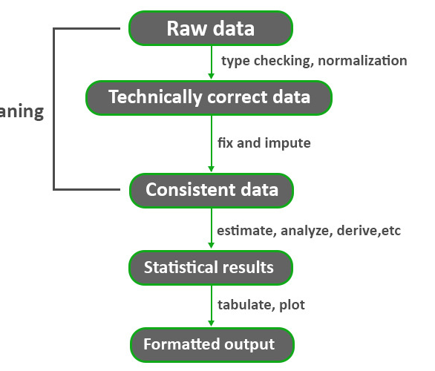
Data Cleaning & Transformation :
Steps followed in Power Query Editor:
- Removed duplicate records
- Changed data types (Date, Number, Text)
- Created new columns:
• Year = YEAR(Order_Date)
• Month = FORMAT(Order_Date, 'MMM')
• Profit Margin = Profit / Amount
- Handled null values and verified consistency across tables

Slide 5
Dashboard Design Overview:
Dashboard Title: ‘E-COMMERCE SALES ANALYSIS'
Key Metrics:
• Total Sales: 191K
• Quantity Sold: 1944
• Profit: 19K
• AOV: 50.06K
Filters: Quarter slicer (Q1, Q2, Q3, Q4)
Visuals Used:
- KPI Cards, Bar Charts, Donut Charts, Column Chart

Slide 6
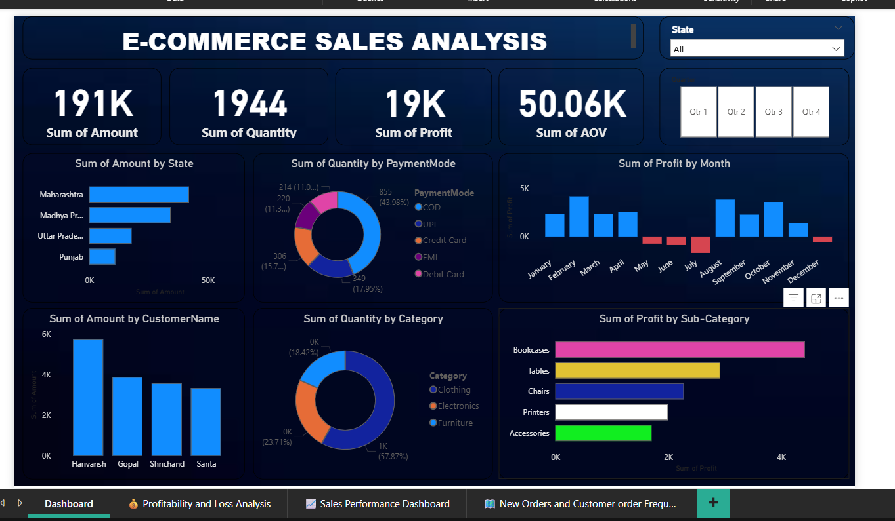
Dashboard Visualization :

Slide 7
Insights & Analysis :
📊 Key Insights:
- Maharashtra, MP, and UP drive highest sales.
- Bookcases and Tables contribute the most profit.
- UPI and COD are most used payment modes.
- July and August show lowest profits due to discounts.
- Category 'Clothing' sells highest in quantity but lower profit margins.
💡 Recommendation:
- Optimize discounts in low-profit months.
- Promote high-margin products in underperforming regions.

Slide 8
THANK YOU SIR.

